Slide 1
CS7/8745 : Machine Learning Instructor: Salim Sazzed Department of Computer Science University of Memphis

Slide 2
Neural Network

Slide 3
Neural Networks
• Origins: Algorithms that try to mimic the brain.
• Widely used in 80s and early 90s; popularity diminished in late 90s.
Computational Power
Theoretical Challenges
Alternatives
Data and Dataset
• Recent resurgence: State-of-the-art technique for many applications
Advancements in computational power
the development of more efficient training algorithms (e.g., backpropagation with techniques like dropout),
the availability of large datasets
breakthroughs in understanding deep learning techniques
Artificial neural networks are still not nearly as complex or intricate as the actual brain structure

Slide 4
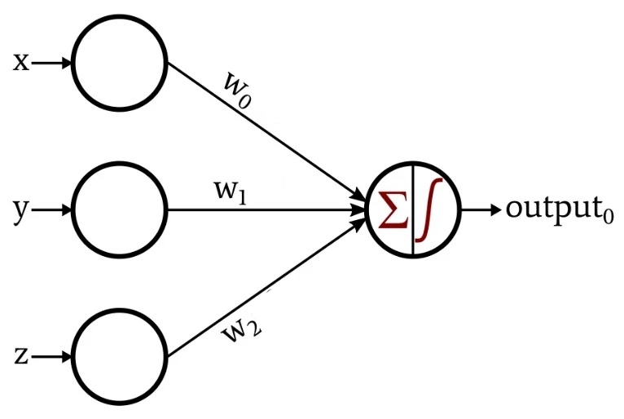
Neural Network in simplest form
Neural networks are made up of nodes or units
Connected by links
Each link has an associated weight and activation level
Each node has an input function (typically summing over weighted inputs), a step (activation) function, and an output.
Single layer: Single layer perceptron can learn only linearly separable patterns.
weights
inputs

Slide 5
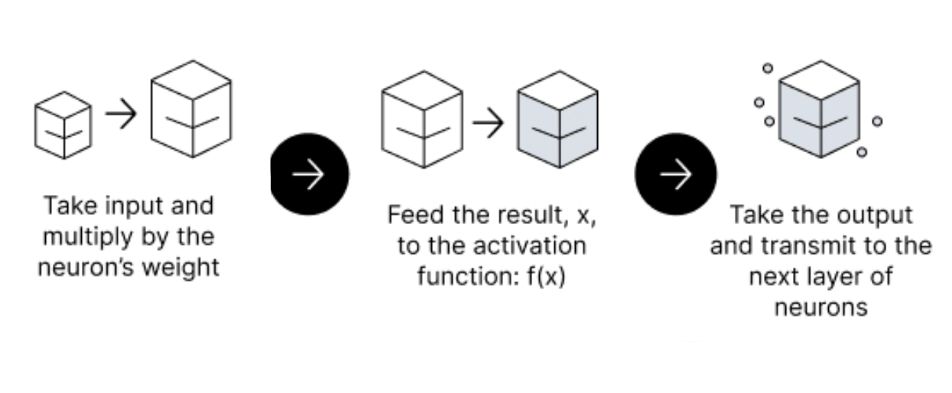
Feedforward Neural Network
The flow of information occurs in the forward direction.
The input is used to calculate one/multiple intermediate function (s), which is then used to calculate an output.
In the feedforward propagation, the Activation Function is a mathematical “gate” in between the input feeding the current neuron and its output going to the next layer.

Slide 6
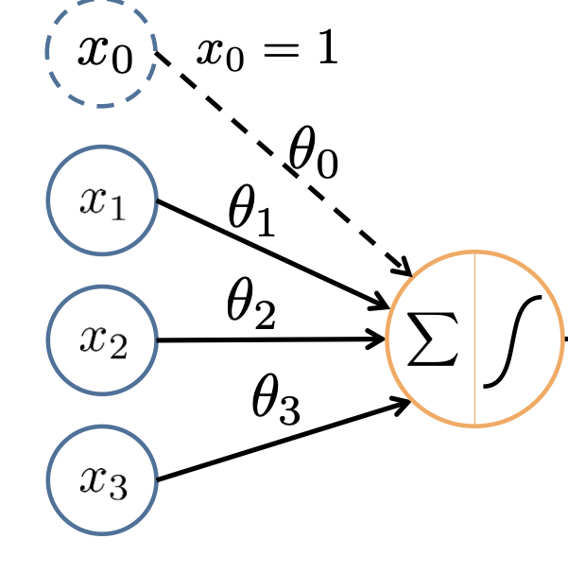
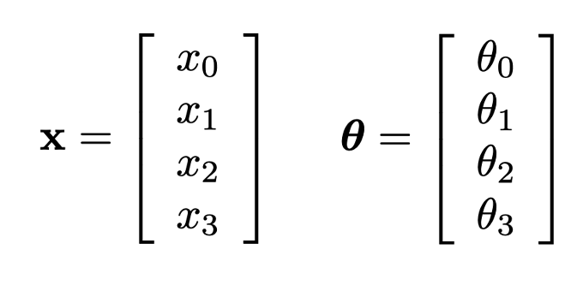
Input function in Neural network
constant input/bias
Input function
activation function
Inputs
Weights
$Input Function=XθT= x_{o}∗θ_{0} + x_{1}∗θ_{1}$+ $x_{2}∗θ_{2} + x_{3}∗θ_{3}$

Slide 7
Activation Function
An Activation Function decides whether a neuron should be activated or not.
A node (in neural network) is a replica of a neuron (brain) that receives a set of input signals—external stimuli.
Depending on the nature and intensity of these input signals, the brain processes them and decides whether the neuron should be activated (“fired”) or not.
In deep learning, this is also the role of the Activation Function—that’s why it’s often referred to as a Transfer Function in Artificial Neural Network.
The primary role of the Activation Function is to transform the summed weighted input from the node into an output value to be fed to the next hidden layer or as output.
Notes:
This means that it will decide whether the neuron’s input to the network is important or not in the process of prediction using simpler mathematical operations.
https://www.v7labs.com/blog/neural-networks-activation-functions#h1

Slide 8
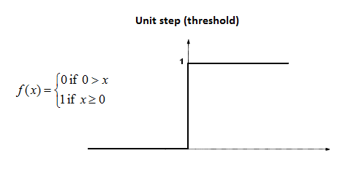
Perceptron (a special type of single feedforward network)
− The perceptron was first proposed by Rosenblatt (1958) is a simple neuron that is used to classify its input into one of two categories.
− A perceptron uses the step function as a activation function

Slide 9
Linear and Non-Linear Functions
Linearity:
The relationship between the input and output variables can be expressed as a straight line (y = mx + b) when graphed on a coordinate plane.
-> output is directly proportional to the input (e.g., weighted combination )
Nonlinearity:
The rate of change of the output variable with respect to the input variable can vary in a non-constant manner.
Non-linear functions can take on various shapes and forms, such as curves, exponential growth, or oscillating patterns.
E.g., y = x^{2,} y = e^{x}

Slide 10
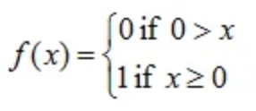
Why Activation Function?
Without an activation function, a neural network would simply be a linear function, which would not be able to capture complex patterns in the data.
Linear functions are functions where the output changes linearly with changes in the input.
For instance, the equation of a line (y = mx + b) represents a linear relationship between variables, where changes in x result in proportional changes in y.
Step function (simplest activation function) is not a linear functions as it's not continuous (there's a sudden jump at the threshold), and the output doesn't change proportionally with changes in the input; it changes discretely.
The activation function helps the network to learn more complex features and patterns in the data,

Slide 11
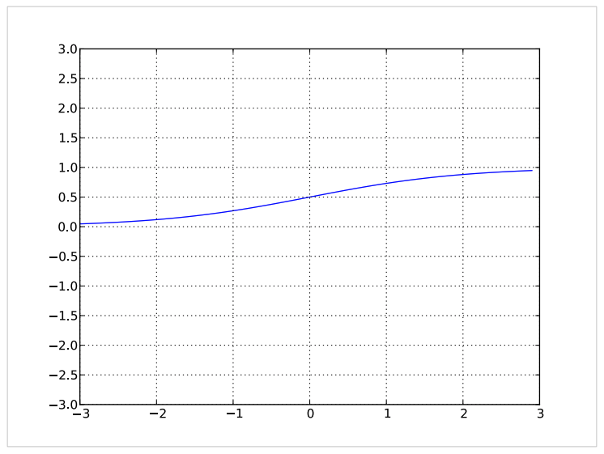
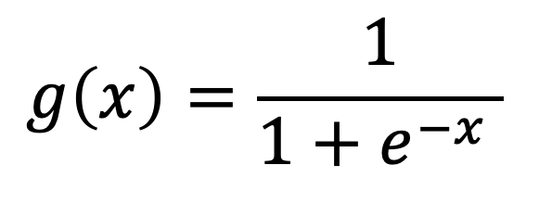
Activation Function - sigmoid
Squashes the neuron’s pre-activation between 0 and 1
Always positive
Bounded
Strictly increasing
$$g\left(x\right)=\frac{1}{1+e^{−x} }$$

Slide 12
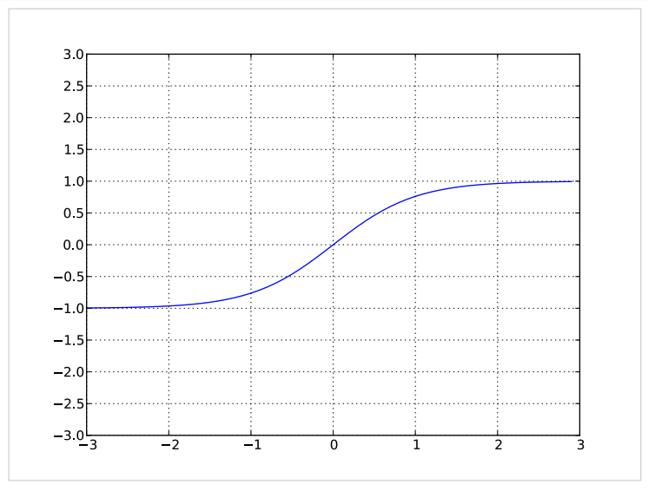
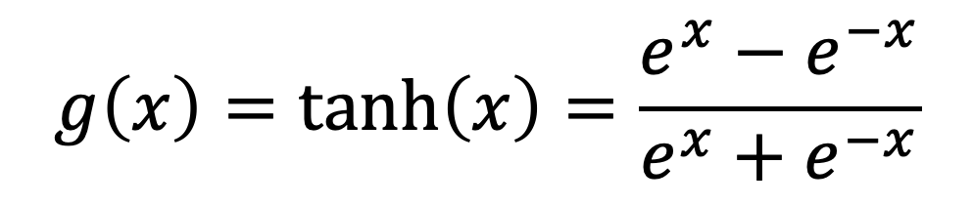
Activation - hyperbolic tangent (tanh)
Squashes the neuron’s pre-activation between -1 and 1
Can be positive or negative
Bounded
Strictly increasing
Zero-centered (mean-centered data can aid in faster convergence)
$$g\left(x\right)=\tanh\left(x\right)=\frac{e^{x}−e^{−x}}{e^{x}+e^{−x}}$$

Slide 13
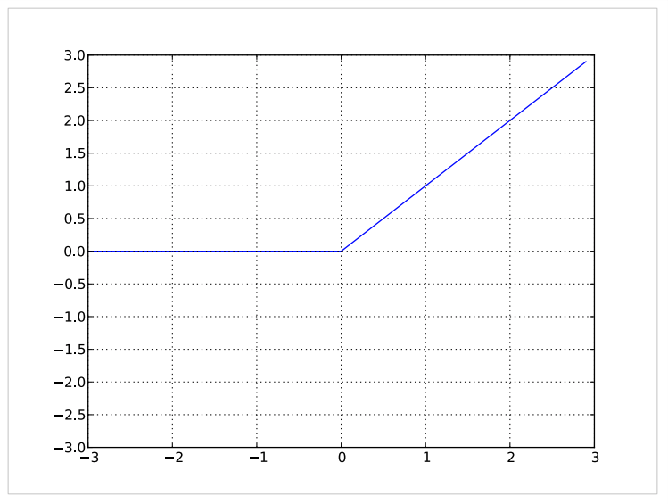
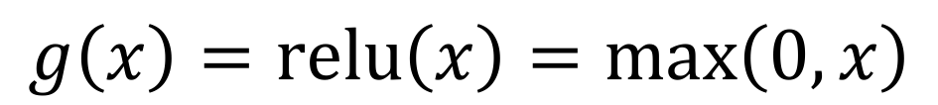
Activation - rectified linear(relu)
Bounded below by 0
always non-negative
Not upper bounded
Tends to give neurons with sparse activities
$$g\left(x\right)=relu\left(x\right)=max\left(0, x\right)$$

Slide 14
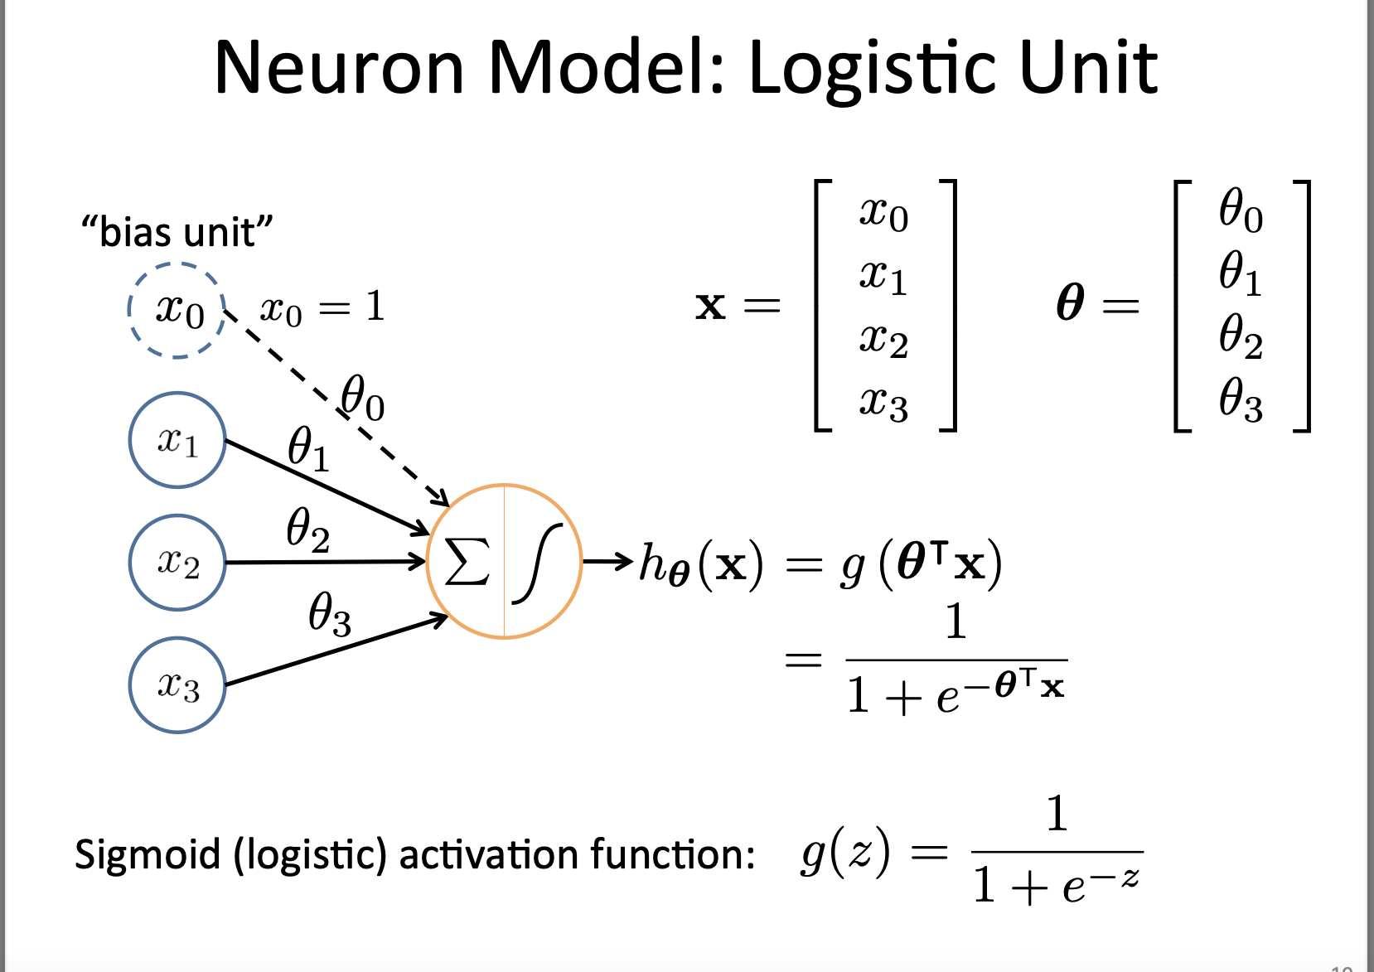
Based on slide by Andrew Ng

Slide 15
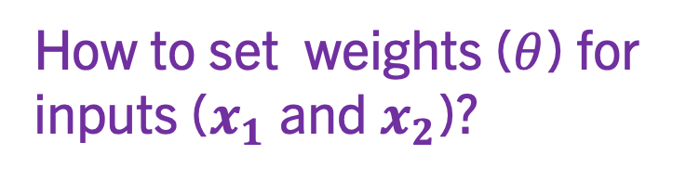
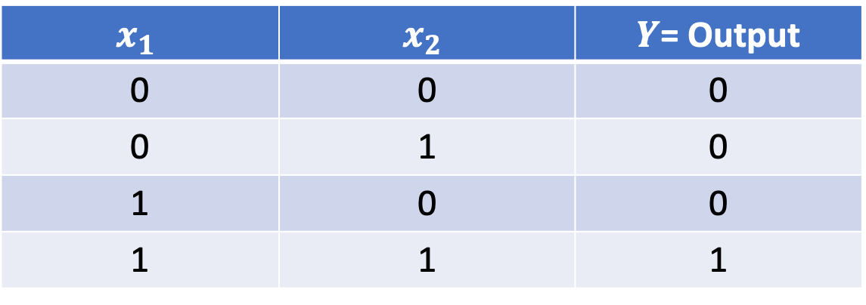
Design and Implement an ‘and’ logic
A logic gate is a fundamental building block of digital circuits .
Utilizes one or more binary (0 or 1) inputs to produce a single binary output. These gates implement the basic
$$x_{1}$$ | $$x_{2}$$ | $Y$= Output
0 | 0 | 0
0 | 1 | 0
1 | 0 | 0
1 | 1 | 1
Truth Table of an ‘and‘ logic gate
AND Gate: The AND gate takes two or more input signals and produces an output signal that is high (1) only if all of its input signals are high.
How to set weights ($θ$) for inputs ($x_{1}$ and $x_{2}$)?

Slide 16
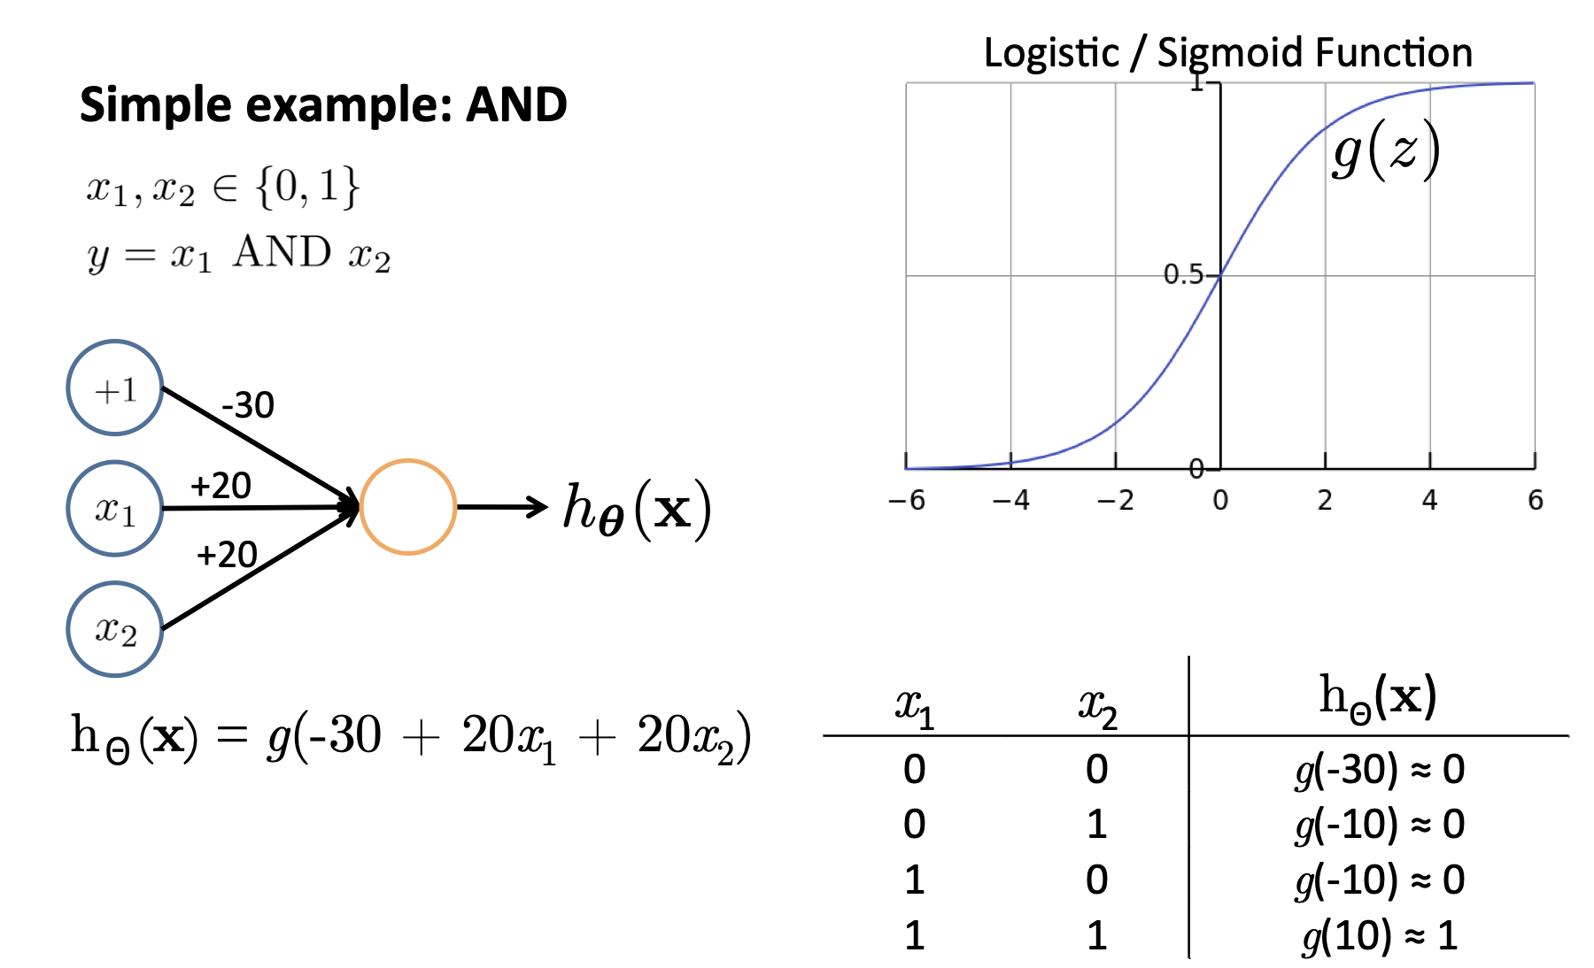
Based on slide and example by Andrew Ng

Slide 17
Good Thing! In the real word, weights are not assigned manually.
- They are initialized to some values and updated through a specialized algorithms called Backpropagation

Slide 18
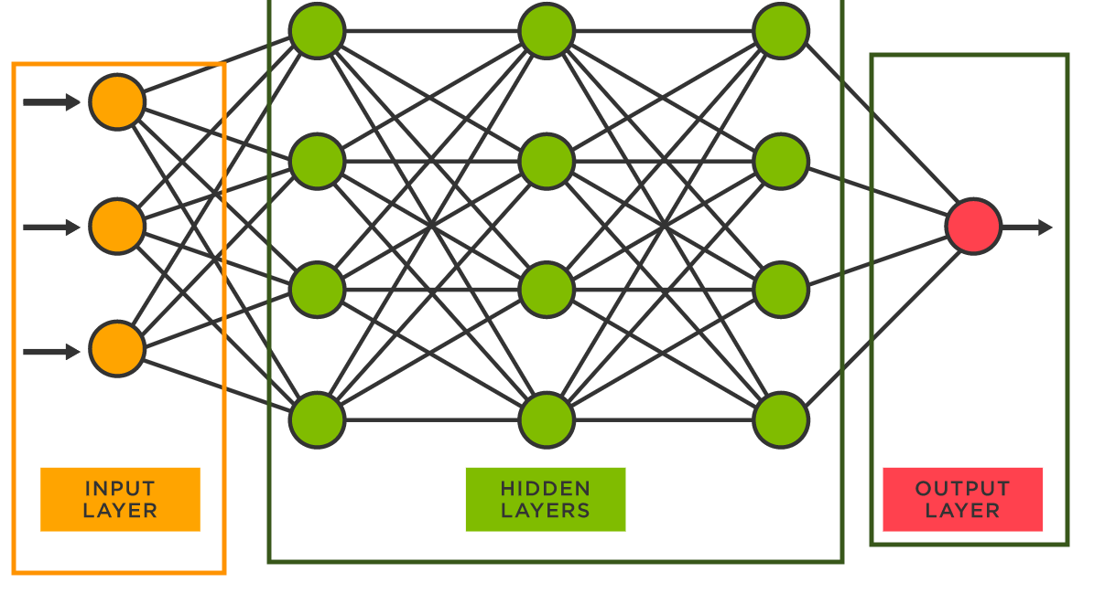
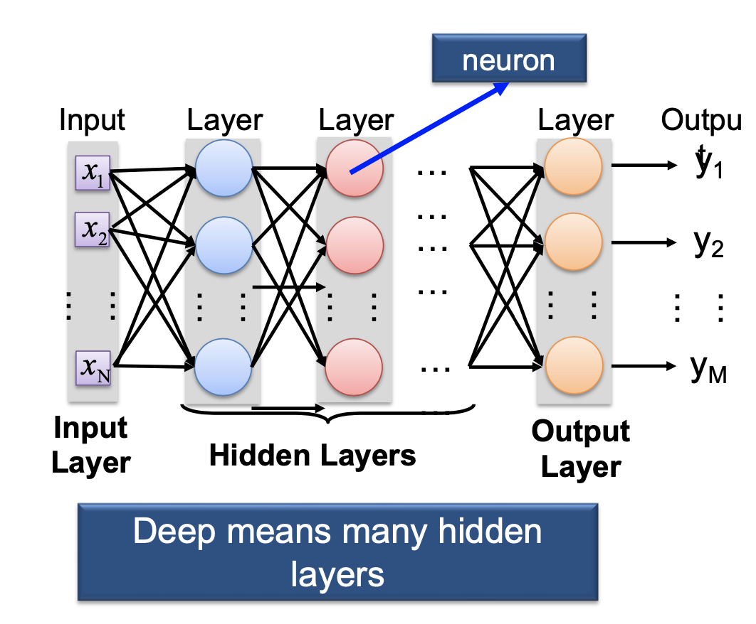
Multiple layers are needed in neural networks to enable them to learn complex and hierarchical patterns in data.
The middle layer of nodes is called the hidden layer, because its values are not observed during the training.
The concept of using multiple layers in a neural network is commonly referred to as deep learning, and networks with more than one hidden layer are called deep neural networks.
Single Output
multiple outputs
https://vitalflux.com/

Slide 19
Loss Function: Classification
Binary Cross-Entropy Loss (Log Loss):
Binary cross-entropy is widely used for binary classification problems where there are two classes (e.g., 0 and 1).
It measures the dissimilarity between predicted probabilities and true binary labels.
where $y_{i}$​ is the true binary label (0 or 1), $p_{i}$​ is the predicted probability of class 1 for the i’th example, and N is the number of examples.

Slide 20
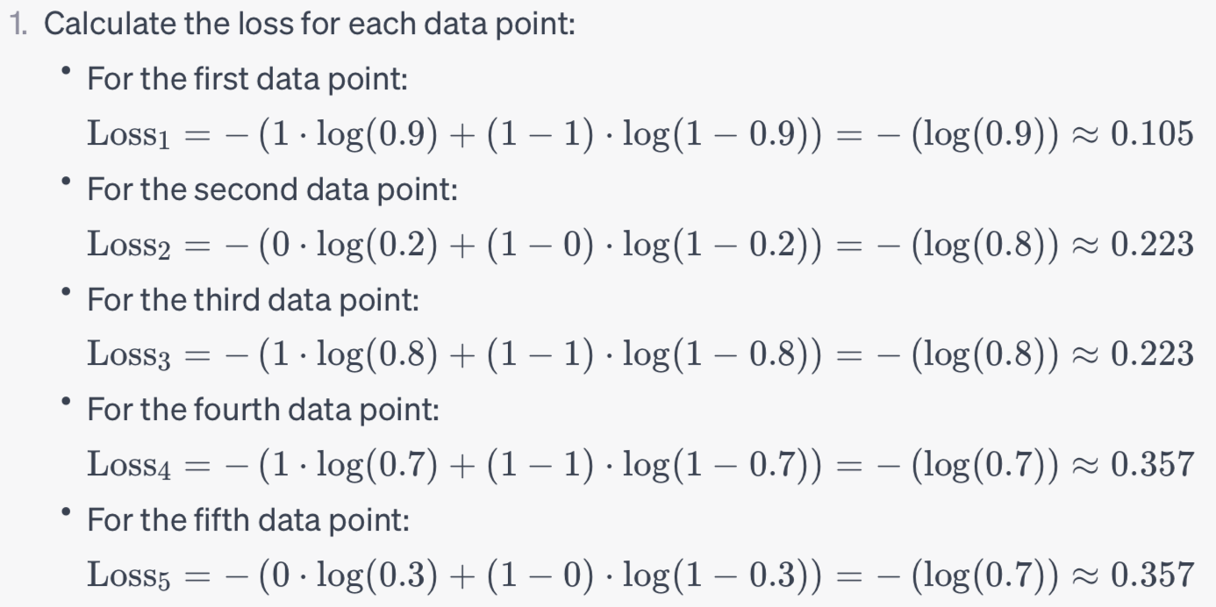
Actual labels ($y$): [1, 0 , 1,1, 0]
Predicted class probabilities ($p$): [0.9, 0.2, 0.8, 0.7, 0.3]

Slide 21
More Details regarding the training process
Forward Pass:
- The input data is fed forward through the neural network, layer by layer, to generate predictions or outputs.
Loss Calculation:
- A loss function is used to measure how well the network's predictions match the actual target values (ground truth). Common loss functions include Mean Squared Error (MSE) for regression tasks and Cross-Entropy Loss for classification tasks.
Backpropagation:
- The gradient of the loss with respect to the network's weights is computed through a process called backpropagation. This involves calculating the gradient of the loss function with respect to the outputs of each neuron in the network.
Gradient Descent:
The gradients computed in the previous step are used to update the weights of the network. The goal is to minimize the loss function, so the weights are adjusted in the direction that reduces the loss.
The update rule for the weights in gradient descent is typically of the form:
new weight=old weight−learning rate ×gradient

Slide 22
Repeat: Steps 1-4 are repeated for multiple iterations or epochs. During each epoch, the network processes the training data, computes gradients, and updates the weights to iteratively improve its performance.
1 Epoch = 1 pass through the entire dataset (all samples)
Update occurs –
1. Based on a single sample (feed one sample -> compute loss -> update weights)--- Stochastic Gradient Descendent
2. Based on multiple samples (e.g., 4,8, 16,32) (Feed multiple samples -> compute loss -> compute overall loss -> update weights)--- Mini-batch Gradient Descendent
3. Based on all samples in dataset (feed all samples -> compute loss -> compute overall loss -> update weights)----- Batch Gradient Descendent
Convergence: Training continues until one or more stopping criteria are met. Common stopping criteria include a maximum number of epochs, achieving a certain level of accuracy, or when the loss stops decreasing significantly.

Slide 23
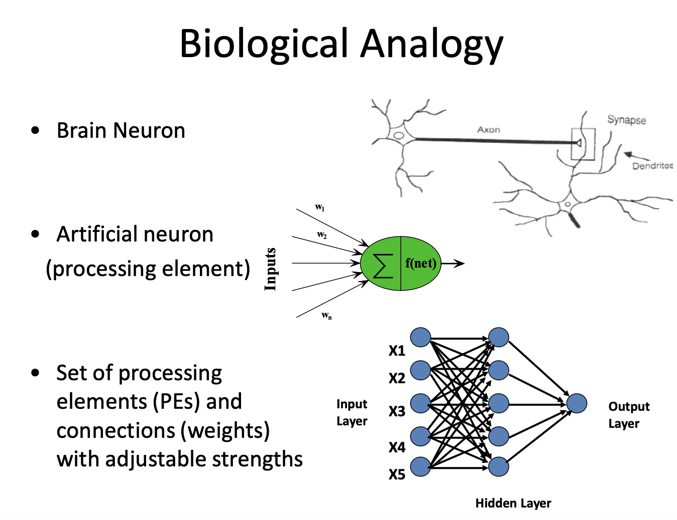
Backpropagation

Slide 24
So far we know-
What is Neural Network
Motivation behind Neural Network
How a simple feedforward neural network works (i.e., a single neuron feedforward neural network)
How incorporating multiple neurons and layers build the theoretical foundation for sophisticated deep neural network (DNN)
However, till now we haven’t learnt anything!!!
(learning requires feedback)

Slide 25


Generalization
Important: How well a model learns from the given data and applies the learned n information elsewhere.

Slide 26
Overfitting:
Deep networks are prone to overfitting, where they perform well on the training data but poorly on unseen data.
Small dataset, too complex model, training model for too long.
Regularization techniques like dropout, L1, and L2 regularization can help mitigate overfitting.

Slide 27
Preventing Overfitting
Dropout: randomly stops some neurons from firing/activation
- yields a more robust/generalizable model
- less reliant on specific input feature(s) or neuron(s)

Slide 28
Regularization
L1 regularization:
Loss (w) = Original Loss Function + λ * L1 Regularization Term
L1(w) = λ * ||w||₁
||w||₁ = |w₁| + |w₂| + ... + |w_{n}|
L2 regularization:
L2(w) = λ * ||w||₂²
L2(w) = λ * ||w||₂
||w||₂ = w₁² + w₂² + ... + w_{n}²

Slide 29
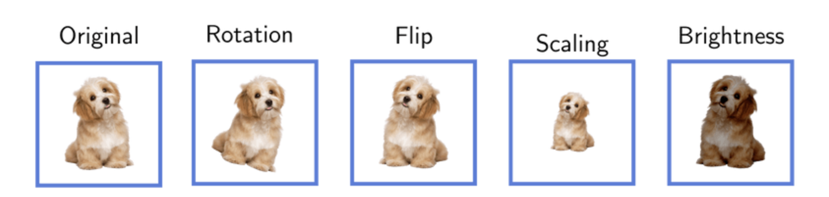
Data Augmentation
https://www.baeldung.com/cs/ml-data-augmentation
https://www.baeldung.com/cs/ml-data-augmentation

